Slide 1
Coffee in Nepal Investment opportunities, Quality & Challenges
Nima Sherpa
Coffee Grower, Processor & Exporter

Slide 2
Introduction
Company: Lekali Coffee Estate
Established: 2008
Location: Bhirkune ( Madanpur VDC, Nuwakot District)
Area Coverage: 20 ha
Altitude: 1100 – 1350 meters
Coffee Varietals: Cattura, Bourbon, Typica
Agricultural Practice: Fully Organic (not certified)
Exporting Countries: North America, Europe & Asia
Member of SCA ( Specialty Coffee Association) : since 2010

Slide 3
Presentation Outline
History of Coffee in Nepal
Current Status
Plantation & Production Trend
Quality of Nepali Coffee
Opportunities
Challenges

Slide 4
History & Evolution of Coffee in Nepal
A saint, Hira Giri of Gulmi district bought some seeds from Myanmar and introduced them in Aapchaur of Gulmi in 1938 AD.
Gradually the plantation of coffee started spreading to adjoining districts of Palpa, Syangja, Kaski, Baglung and others.
Commercial cultivation started since 1990s
Currently more than 42 districts of Nepal are currently growing coffee.
Notes:
Hira Giri planted the first coffee seeds in 1938 in the Aapchaur of Gulmi District, bringing the seeds from the Myanmar .
In the eighties, coffee plantations were as a means to prevent soil erosion.
Farmers, mainly mid-hill, started recognizing coffee as a high-value crop post-2002, seeing growing exports combined with increasing domestic consumption. Globally, it was the early years of coffee’s third wave.

Slide 5
Current Status of Nepali Coffee
Total Plantation Area: 2021/2022 = 3346 hectares
Potential Land Area for coffee cultivation = 1.19 million ha
Potential Land Area for Specialty Coffee Cultivation = 60k HA
Total Production for 2021/2022 = 354.9 Metric Tons
Total Number of Farmers Involved = 31389
Total Number of Coffee Growing Districts = 42

Slide 6
PRODUCTION TREND
IMPORTS
EXPORTS
FISCAL YEAR | QUANTITY IN MT
2021/2022 | 279 Metric Tons
FISCAL YEAR | QUANTITY IN MT
2021/2022 | 69 Metric Tons
Data source: Trade & Export Promotion Center and Department of Customs, Nepal
Notes:
Almost 280 tons of coffee was imported in the FY 2021/22, a 40% growth in imports compared to the previous fiscal year.
Domestic Consumption of Coffee is over 70%.
The demand is met by farming which has expanded to 44 districts, and across 31,340 small farmers

Slide 7
Quality: it all starts at the Farm
Notes:
A very well processed coffee is like looking through from a very clean window ” George Howeel”

Slide 8
What does it take to make Quality Coffee?
Proper varietal selection
Good coffee nursery practices
Eye for detail in processing
Approach processing in a more scientific way

Slide 9
What’s in for Farmers?
Fetch better Prices for your coffee
Prices not related to NY “ C” market
Opportunities to showcase the best MICRO LOTS
Build a direct relationship with buyers
Good quality = Premium Price = Better living conditions
Trade is more direct
Catered towards third-wave coffee culture

Slide 10
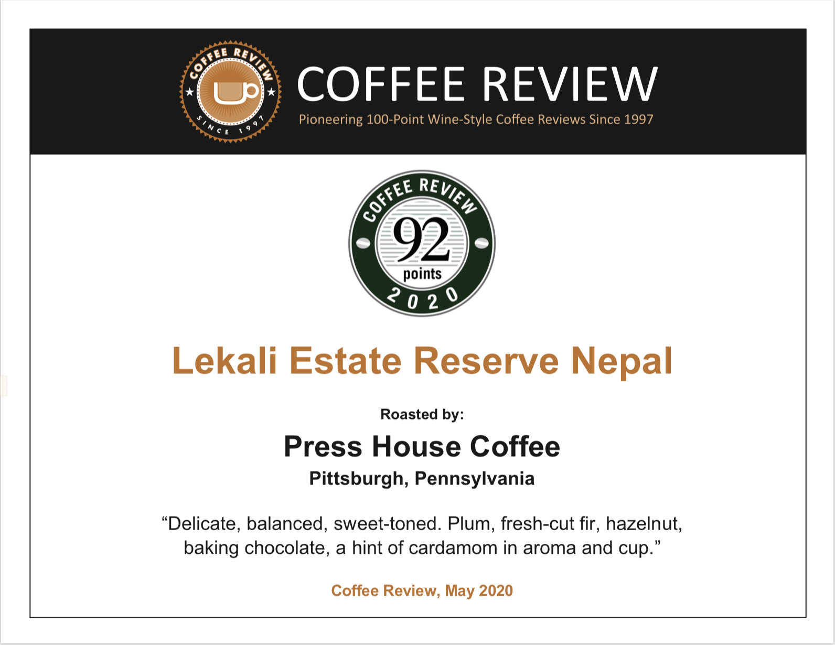
Success Stories for Nepali Coffee
COFFEE REVIEW GIVES 90 SCORE FOR NEPALI COFFEE

Slide 11
EU – QUALITY CHAMPIONS PROGRAM
Trade and Investment project under the Ministry of Industry and Commerce implemented by ITC has introduced the LEAN management system in Nepal with an aim to improve the quality of coffee through the development of Quality Champions
Twenty-one persons participating in Lean Green Belt training to qualify as Quality Champions.

Slide 12
Lean in Coffee Sector in Nepal
After the training, the quality champions are working with 12 SMEs including
Coffee exporters
Coffee processors
Coffee producers
Coffee shops
Training modality
Visit of the SME by Quality Champion for need assessment before the training
3-day action workshop with the SME to energize them
Second 3-day action workshop after about one month of the first workshop to optimize their process.
Facilitate three small projects encompassing LEAN principles for continuous improvement with measured impact

Slide 13
Coffee in Nepal: An Opportunity
Climate and soil condition of the Mid-hills of Nepal is suitable for growing Arabica coffee. Coffee in Nepal is 100% Arabica.
Around 1.19 million ha land potential for coffee production
Opportunity for the production of high-grown, organic specialty coffee.
High international demand for specialty coffee. Approx 8000 to 10000 MT.
Participation of small farmers.
Rural employment generation through processing industries & dry milling.
Opportunities for donor agencies to focus more on production & quality.
Notes:
Nepali coffee is exclusively Arabica variety and qualifies as a specialty coffee in specific markets for its distinct aroma & taste.
Government needs to unlock access to underutilized lands for commercial coffee plantations.
Growing interest of Nepali Coffee among specialty traders and roasters in North America, Australia, the Middle East, and East Asia.
Germany, Japan, Switzerland, Netherlands and Australia were the leading exports market for Nepal in the FY 2020/21.
The demand is met by farming that has expanded to 44 districts, and across 31,340 small farmers

Slide 14
Challenges
Climate change is a threat
Pests & disease . Increasing incidence of insect (white stem borer) and diseases (coffee leaf rust, Cercospora and anthracnose).
Inadequate research in varietal selection
Access to proper coffee equipment & training in coffee processing plants ( wet mill, storage & dry mill)
Access to finance for private coffee estates and smallholder farmers.
Access to training on sustainable coffee production for farmers.
Setting up proper storage facilities

Slide 15
Questions?

